Slide 1
AI Foundations
Introduction to AI/ML

Slide 2
Table of Contents
What is AI
The subfields of AI
AI Applications
What is Machine Learning
The kinds of Machine Learning
ML Applications
Download of Anaconda distribution for Python

Slide 3
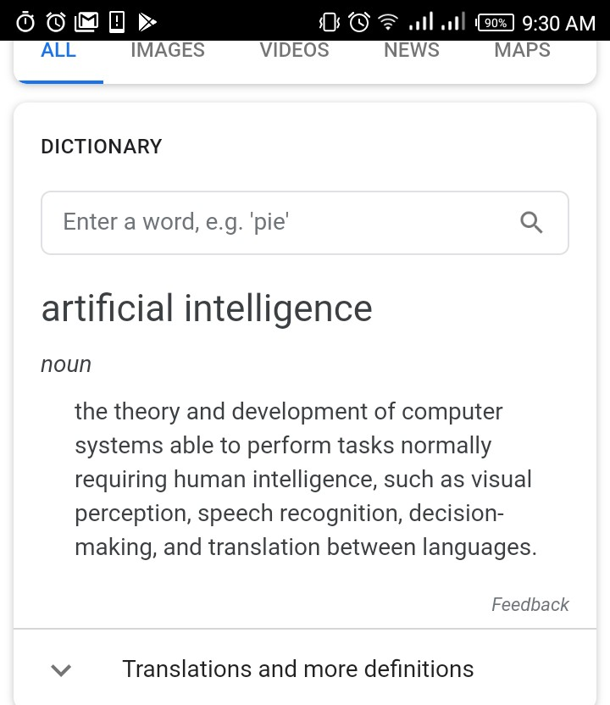
What is AI
the theory and development of computer systems able to perform tasks normally requiring human intelligence, such as visual perception, speech recognition, decision-making, and translation between languages.
- Google Dictionary

Slide 4
What is AI
Simply put, Artificial Intelligence is about development of computer systems that are able to perform tasks that usually require human intelligence.
eg. visual perception, speech recognition, decision-making, translation between languages, predictions, classifications.

Slide 5
The subfields of AI
Data Science - Business Analytics, Business Intelligence
Neural Networks and Cognitive Science - mimics neurology
Image Processing and Multimedia Analysis- computer vision, speech recognision, NLP
Robotic and Embedded Systems - hardware & software
Machine Learning - statistical models

Slide 6
AI Applications
Virtual Personal Assistant eg. Apple Siri, IBM Watson Assistant, Google Now, Cortana
Chatbots
Self driving cars
Music & Movie recommendation services eg. Netflix, Amazon
Smart Home devices
Robots & Humanoids eg. Sophia

Slide 7
What is Machine Learning
Machine learning is sub-field of AI that deals with developing computer systems that are capable of learning from data to solve problems without being explicitly programmed.

Slide 8
The kinds of Machine Learning
Supervised Learning- this is where machine is guided by labeled data.
Unsupervised Learning- this is where machine has to find structure from unlabeled data.
Reinforcement Learning - this is where agent acts based on rewards and punishments.

Slide 9
ML Applications
Prediction of house prices
Prediction of stock prices
Recommendation systems:friends(eg. Facebook,LinkedIn), movies(eg.Netflix), music(eg. Apple Music), sale of items(eg.Amazon, Ebay), videos(YouTube), news(eg. Google Newstand)

Slide 10
ML Applications
Email spam and malware filtering system
Predicting whether a patient a has a certain disease/not (eg.cancer)
Sorting out different articles according to their content
Sorting images
Online fraud detection

Slide 11
Download of Anaconda distribution for Python
https://www.anaconda.com/download/#windows

